Slide 1
Crime Analysis and Prediction using Machine Learning
Presented by: Student ID:

Slide 2
Introduction
Crime affects people’s safety and daily life. Police collect large amounts of crime data, but it is difficult to study it manually.
Machine learning can help by:
Finding patterns in crime data
Identifying high-risk areas
Predicting future crime levels
This project uses real crime data to support better decisions for safety and planning.

Slide 3
Research Objectives
To analyse crime patterns over time and location
To identify crime hotspots
To predict future crime levels
To understand which factors affect crime the most

Slide 4
Research Questions
RQ1: Which areas are crime hotspots?
RQ2: Can we predict future crime levels?
RQ3: Which features are most important for prediction?

Slide 5
Dataset Description
Licensed and Open Source: UK Police Open Data
Total records: 772,974
Time period: October 2023 to December 2025
Areas covered: 1963 LSOA regions
Police forces:
West Midlands Police
City of London Police
The dataset does not contain personal data and is safe for research use.
Notes:
LSOA: Lower Layer Super Output Areas (LSOAs) are small, consistent geographic units used in England and Wales for collecting and publishing statistical data

Slide 6
Dataset Features
Spatial Features
Latitude
Longitude
LSOA code
Crime Features
Crime type
Outcome category
Time Features
Month
Year
Feature Selection (for Modelling)
SelectKBest was used to rank features based on their importance
The most useful features were selected for prediction
This helps reduce noise and improves model performance

Slide 7
Data Preparation
Combined 54 CSV files into one dataset
Removed missing and invalid values
Converted dates into year and month
Grouped data into LSOA-month level
This step made the data ready for analysis and modelling.

Slide 8
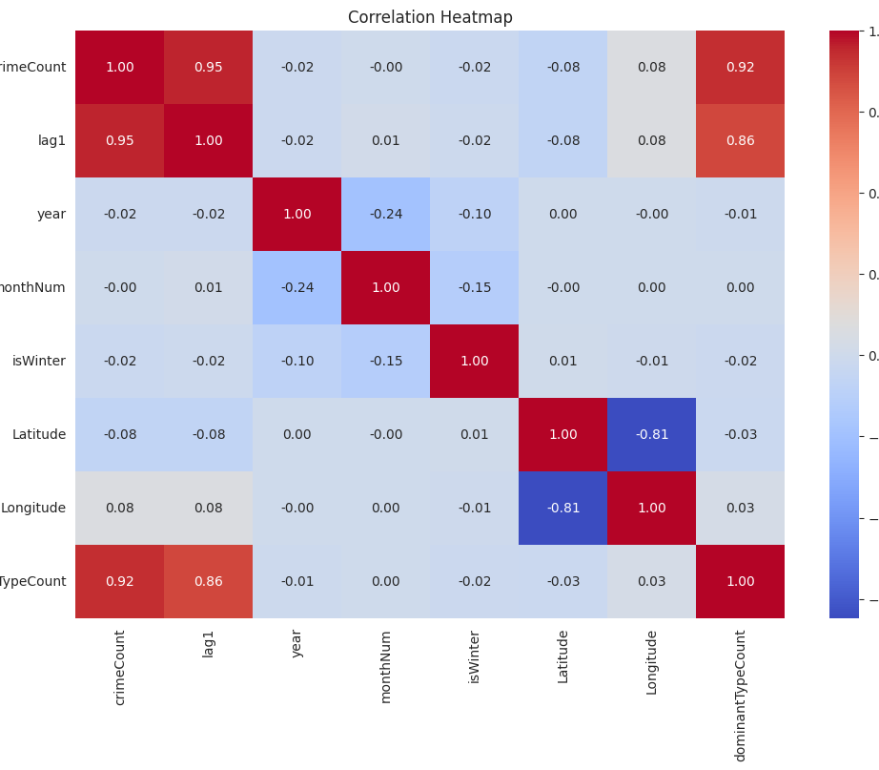
Feature Correlation Heatmap
This heatmap shows how different features are related to each other. Strong positive values (red) mean features move together, while negative values (blue) show opposite trends. It helps identify important features like lag1 and dominantTypeCount for prediction.

Slide 9
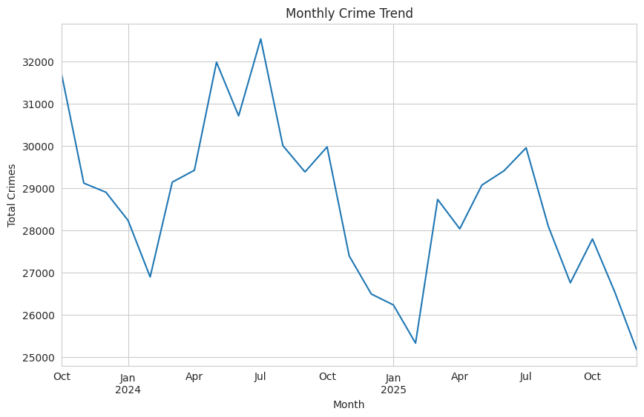
Monthly Crime Trend
This graph shows how crime levels change over time each month. Crime rises and falls, with peaks in mid-2024 and a drop in early 2025. This suggests crime follows a time-based pattern.

Slide 10
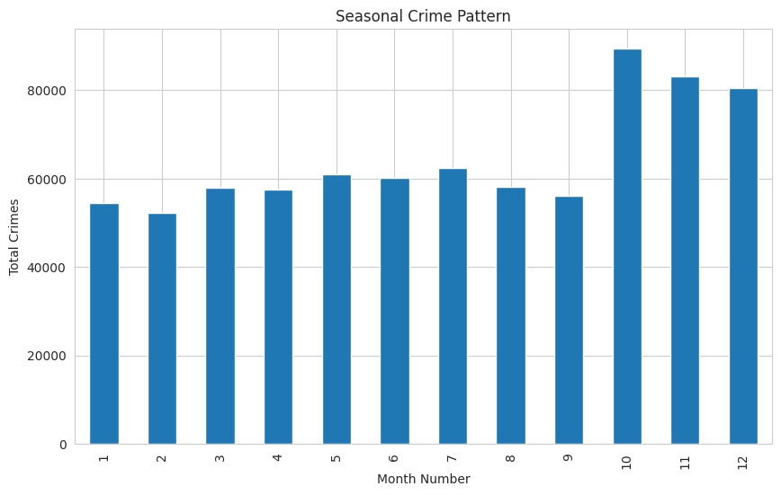
Seasonal Crime Pattern
This graph shows how crime levels vary across different months of the year. Some months, especially towards the end of the year, have higher crime rates compared to others. This indicates that crime follows a seasonal pattern.

Slide 11
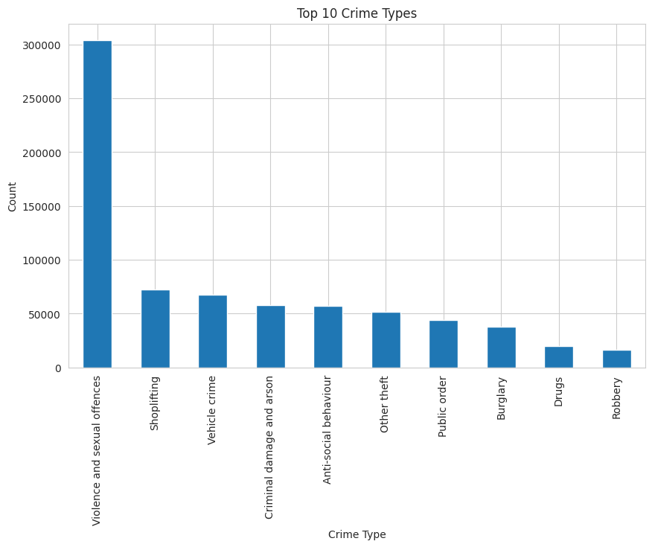
Top Crime Types
This graph shows the most common types of crime in the dataset. Violence and sexual offences have the highest count, followed by shoplifting and vehicle crime. This shows that theft-related crimes are also very frequent.

Slide 12
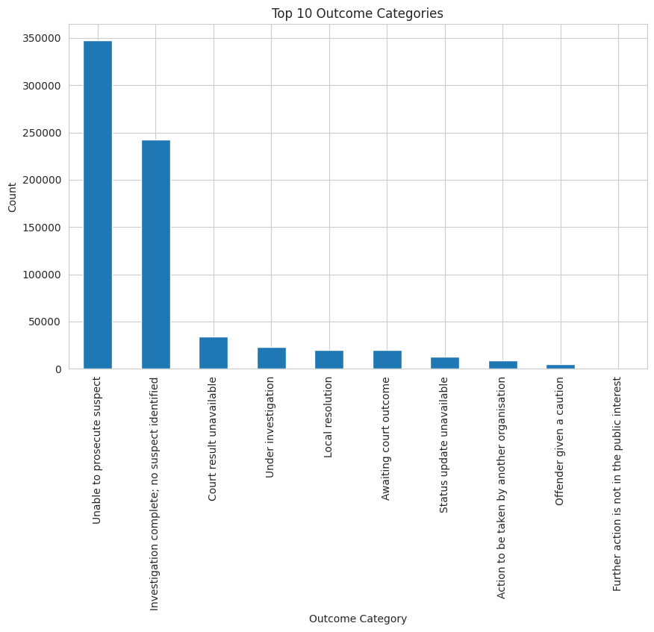
Outcome Categories
This graph shows the outcomes of reported crimes. Most cases end with no suspect identified or are unable to be prosecuted. This highlights limitations in crime resolution.

Slide 13
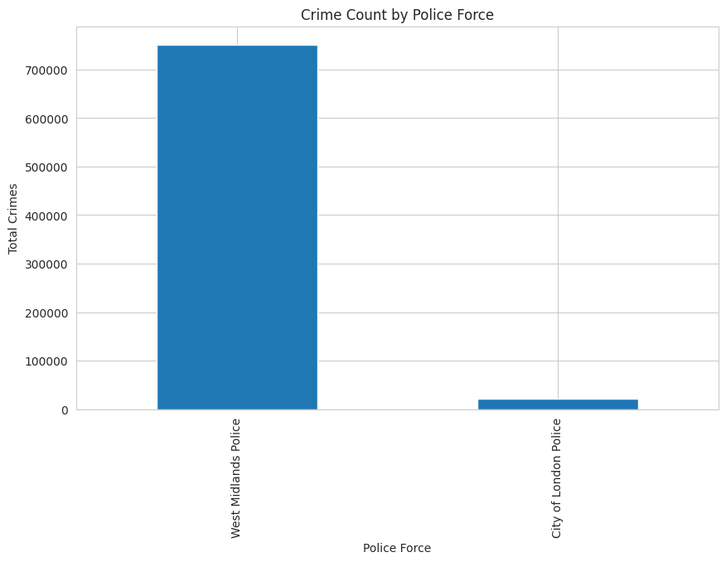
Crime Reports by Police Force
This graph shows the number of crimes reported by each police force. Most of the data comes from West Midlands Police, while City of London Police contributes a much smaller portion.

Slide 14
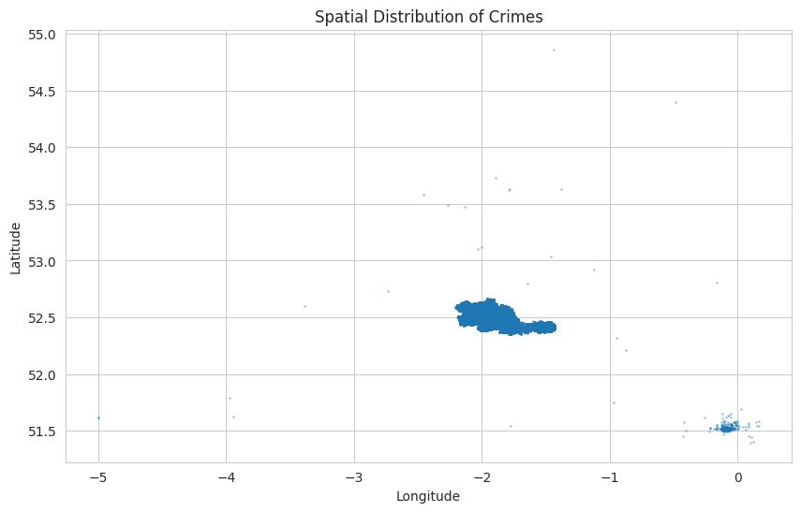
Spatial Distribution of Crime
This graph shows the spatial location of crimes using longitude (x-axis) and latitude (y-axis), where values such as 0, -1, and -2 represent geographic coordinates on the map. The points are not evenly distributed, and most crimes are concentrated in specific areas. This indicates that certain locations experience higher crime levels than others.
Notes:
Longitude (X-axis)
Moves left → west
Moves right → east
Examples:
-5 = far west (like Wales side)
-2 = central UK (Manchester area)
0 = east side (London region)
Latitude (Y-axis)
Moves down → south
Moves up → north
Examples:
51.5 = London area
52.5 = Midlands / Manchester
54+ = northern UK

Slide 15
Hotspot Detection (RQ1)
Two clustering methods were used:
KMeans
Silhouette score: 0.26
Weak clustering
DBSCAN
Silhouette score: 0.74
Strong clustering
DBSCAN performs better for this task.
Notes:
What K-Means does
K-Means:
Divides data into K fixed clusters
Each cluster has a center (centroid)
Points are assigned to the nearest center
Key assumption:
Clusters are:
Circular
Similar size
Evenly distributed
What DBSCAN does
DBSCAN groups points based on density, not distance to a center.
It uses two main ideas:
Points close together → cluster
Sparse points → noise
Silhouette Score: Goodness of clustering.
how similar a data point is to its own cluster

Slide 16
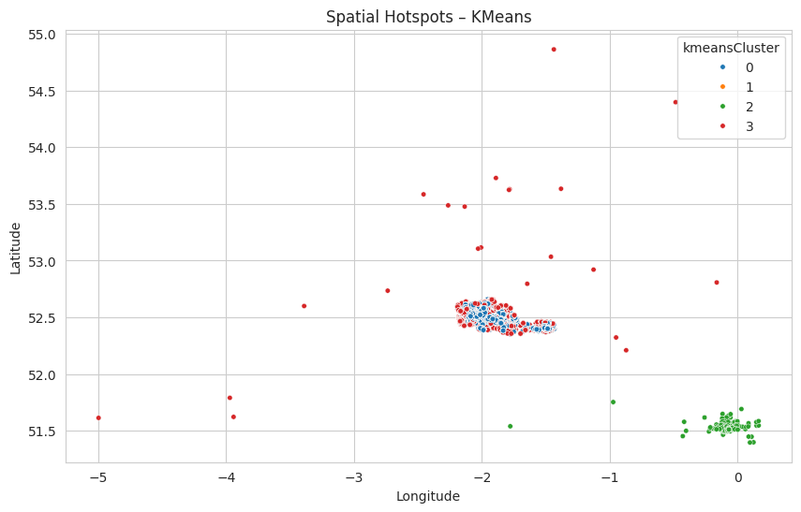
KMeans Clusters
This graph shows how KMeans groups locations into clusters based on their coordinates. The numbers like 0, 1, 2, and 3 represent different cluster groups, not crime levels. The values on the axes such as 0, -1, and -2 represent longitude and latitude coordinates. Each colour shows a group of nearby locations, but the model does not clearly separate very high-crime areas.

Slide 17
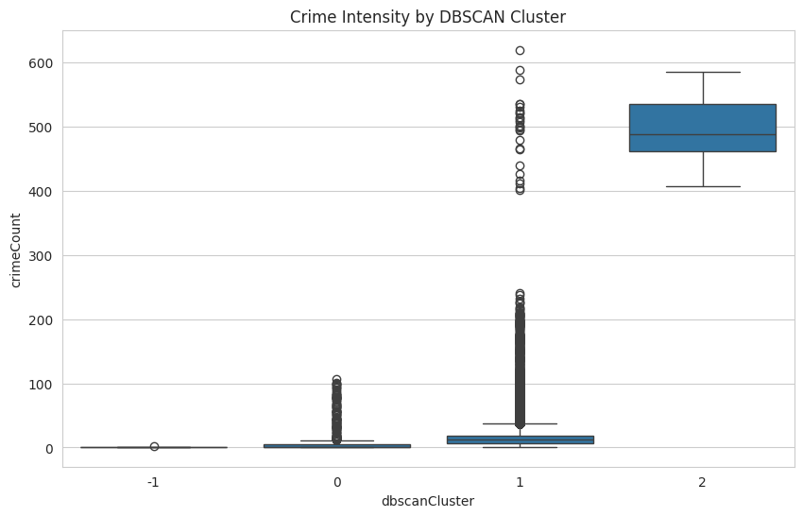
DBSCAN Hotspots
This graph shows crime intensity for each DBSCAN cluster using a boxplot. The numbers (-1, 0, 1, 2) represent different clusters, where
-1 indicates outliers that do not belong to any cluster. The box shows the middle range of data, and the line inside it is the median crime count. The whiskers show the normal spread of values, while the small circles outside the whiskers are outliers. These outliers represent unusual crime counts that are much higher or lower than typical values. One cluster clearly shows very high crime levels, which helps identify strong crime hotspots.

Slide 18
Crime Prediction Models (RQ2)
Two models were used:
Linear Regression
Random Forest
The goal is to predict crime for the next month and for a specific region.
Why use these two model:
We are testing whether crime prediction is simple (linear) or complex (non-linear).
Notes:
For RQ2, two regression models were used: Linear Regression and Random Forest. The goal is to predict crime count for the next month based on historical and spatial features. Linear Regression provides a simple baseline by modeling linear relationships, while Random Forest captures more complex patterns and interactions in the data. This comparison helps evaluate whether crime patterns are simple or require more advanced modeling techniques.
Strengths
Simple and easy to understand
Fast
Good baseline model
Weaknesses (important)
Cannot capture complex patterns
Struggles with:
Non-linear data
Interactions between features
Sensitive to multicollinearity (you saw this in heatmap)
What it does
Random Forest is:
A collection of many decision trees
Each tree:
Makes a prediction
Final result = average of all trees

Slide 19
Model Performance
Linear Regression:
RMSE: 5.35
Random Forest:
RMSE: 4.84
Random Forest performs better because it handles complex patterns.
Notes:
How to understand RMSE
Lower RMSE = better model
Higher RMSE = worse model

Slide 20
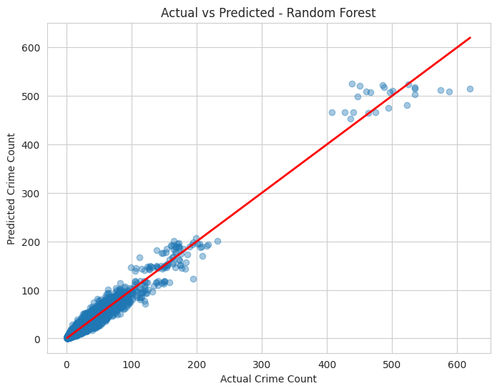
Actual vs Predicted
This graph compares actual crime counts with predicted values. The red line represents perfect predictions. Most points lie close to this line, which shows the model is performing well. A few points further away indicate some prediction errors, especially at higher crime values.
Notes:
This plot compares actual and predicted crime values for the Random Forest model. The red line represents perfect predictions. Most points lie close to this line, indicating strong model performance, especially for low and medium crime levels. However, at higher crime values, the points are more spread out and often fall below the line, showing that the model tends to underestimate extreme cases. This suggests that while the model performs well overall, predicting very high crime levels remains more challenging.

Slide 21
Overfitting Analysis
Train RMSE: 1.83 Test RMSE: 4.84
Big gap → overfitting
The model performs much better on training data. This shows overfitting.
Notes:
Overfitting = model learns training data too well but fails on new data

Slide 22
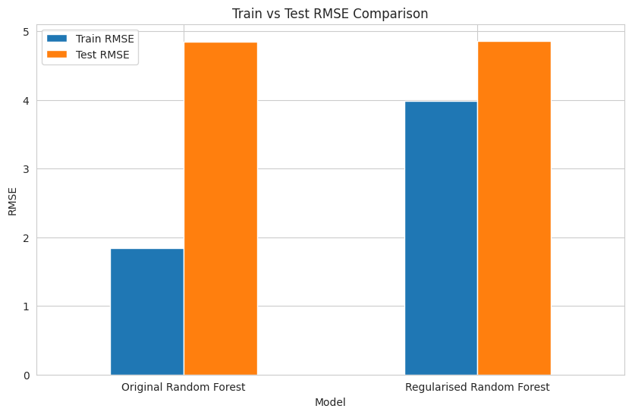
Regularisation
After limiting model complexity:
Train RMSE: 3.98 Test RMSE: 4.85
The gap between train and test reduces. This improves generalisation.
Notes:
Regularisation means:
Limiting tree depth
Reducing splits
Making trees less complex
So instead of memorising data, the model:
Learns more general patterns
Your results
Before (Overfitting slide)
Train RMSE = 1.83
Test RMSE = 4.84
👉 Big gap → overfitting
After Regularisation
Train RMSE = 3.98
Test RMSE = 4.85

Slide 23
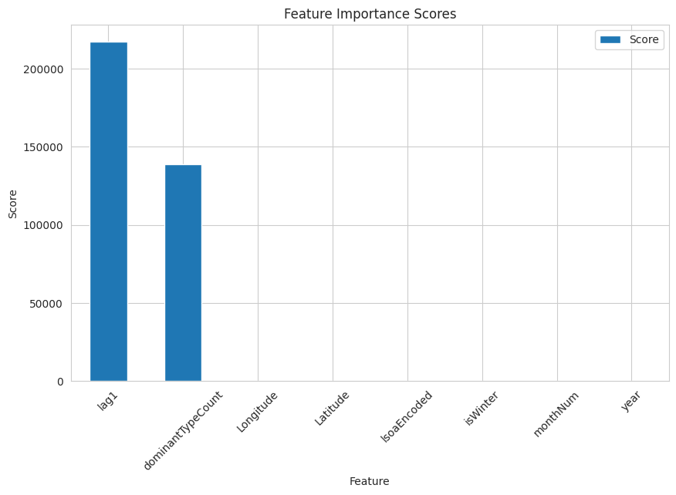
Feature Importance (RQ3)
Top features:
Previous crime (lag1)
Dominant crime type
Location
Previous crime is the most important factor.
Notes:
The feature importance results show that the most influential factor in predicting crime is the previous crime count (lag1), indicating strong temporal dependency. The dominant crime type and location features also contribute significantly, reflecting spatial clustering and crime patterns. Other features such as month, year, and seasonal indicators have relatively low importance, suggesting they have a weaker direct impact on crime prediction.

Slide 24
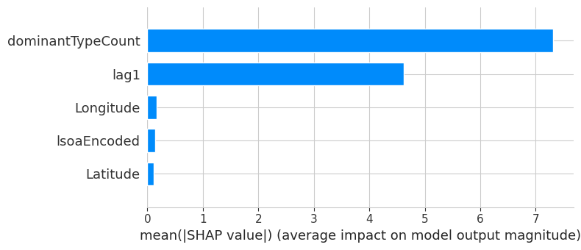
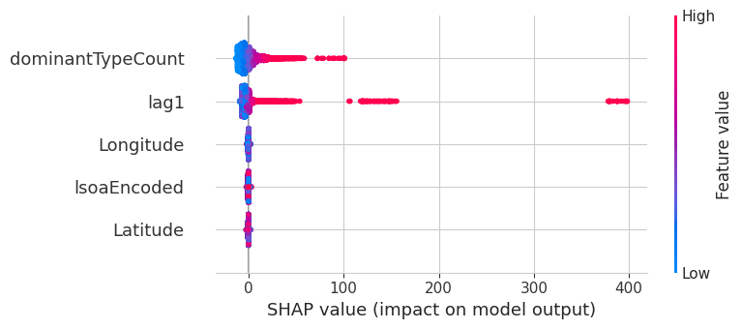
SHAP Analysis
How exactly does each feature influence the model’s predictions?
This figure shows SHAP analysis using two plots. The left plot shows how each feature affects individual predictions, while the right plot shows overall feature importance. It is clear that dominant crime type and past crime (lag1) have the highest impact on predictions, while location features have a smaller effect.
Notes:
SHAP explains how much each feature pushes a prediction up or down.
The SHAP analysis provides a detailed explanation of how each feature influences predictions. The summary plot shows that higher values of dominant crime type and previous crime significantly increase predicted crime levels. The global importance plot confirms that these features have the largest overall impact, while location features contribute less. This demonstrates that both temporal and crime-type factors are the main drivers of the model’s predictions.

Slide 25
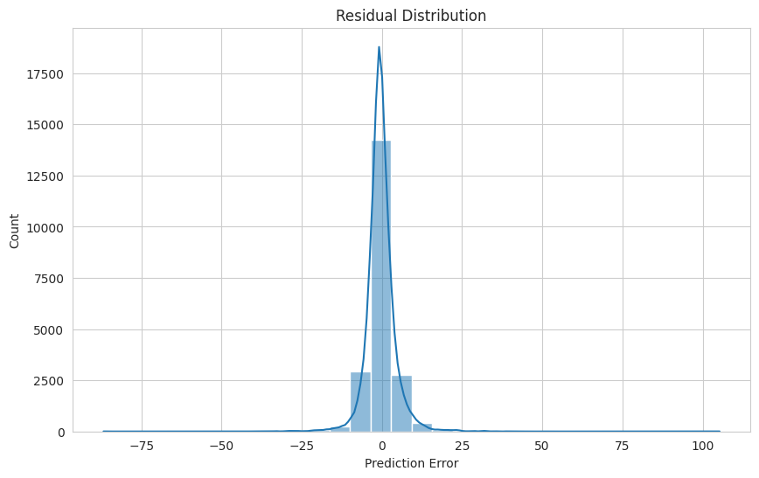
Model Validation
Are the model errors reasonable and well-behaved?
This graph shows the distribution of prediction errors (residuals). Most errors are centred around zero, which means the model predictions are close to actual values. A few larger errors exist on both sides, but overall the model is stable and performs well.
Notes:
Symmetrical shape
The graph looks roughly balanced:
Errors on left (negative)
Errors on right (positive)
Meaning:
Model is not biased (not always over or under predicting)
Good model behaviour
Ideal residual distribution should be:
Centered at zero ✅
Symmetrical ✅
Narrow spread ✅
Residual = 0 → perfect prediction
Positive residual → model underpredicted
Negative residual → model overpredicted

Slide 26
Hyperparameter Tuning
Initial Random Forest
RMSE: 4.84
Baseline model without tuning
Regularised Random Forest
RMSE: ~4.86
No clear improvement
Hyperparameter Tuning (Randomised Search)
Tuned: tree depth, estimators, split size
Used cross-validation for better selection
Final Tuned Model
RMSE: 4.62
Best performance achieved
More accurate and generalised model

Slide 27
Function – predictNextMonthCrime
Predicts next month’s crime for a given location
Accepts input: area name, street, or coordinates
Matches input to LSOA area
Uses trained model to estimate crime count
Assigns a risk level (Low, Medium, High, Very High)

Slide 28
Real World Example
Example 1:
Location: Chancery Lane
Predicted crime: 3.7
Risk level: Low
Example 2:
High crime area
Predicted crime: 490
Risk level: Very High
Shows how the system can be used in real life
Helps users quickly understand crime risk in different areas

Slide 29
Practical Use
Police:
Plan patrol routes
Focus on high-risk areas
Public:
Check safety before renting
Government:
Improve safety planning

Slide 30
Conclusion
DBSCAN is best for hotspot detection. Random Forest is best for prediction.
Past crime and location are the most important features.
This system can support real-world decision making.

Slide 31
THANK YOU FOR
YOUR TIME TODAY

